Slide 1
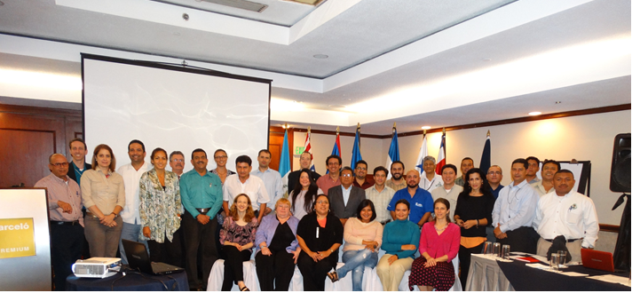
REPORT OF THE THIRD REGIONAL CAPACITY BUILDING WORKSHOP ON NON DETRIMENT FINDINGS FOR CITES AND FISHING AUTHORITIES IN CENTRAL AMERICA AND THE DOMINICAN REPUBLIC
November 25-27, 2014, Santa Marta, Colombia

Slide 2
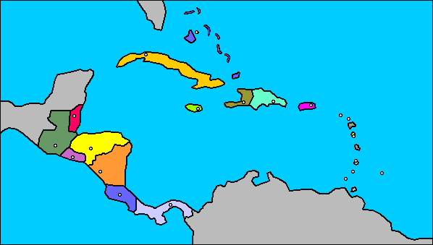
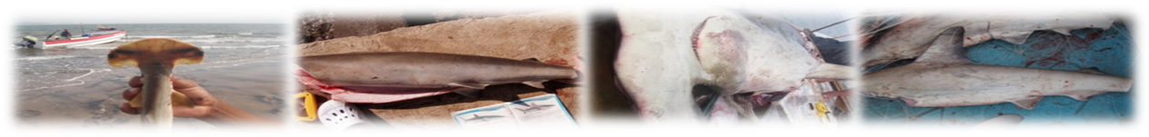
OSPESCA COUNTRIES
1. Belize
2. Costa Rica
3. El Salvador
4. Guatemala
5. Honduras
6. Nicaragua
7. Panamá
8. Dominican Republic

Slide 3
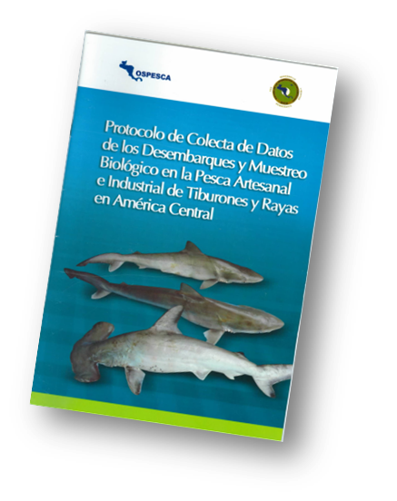
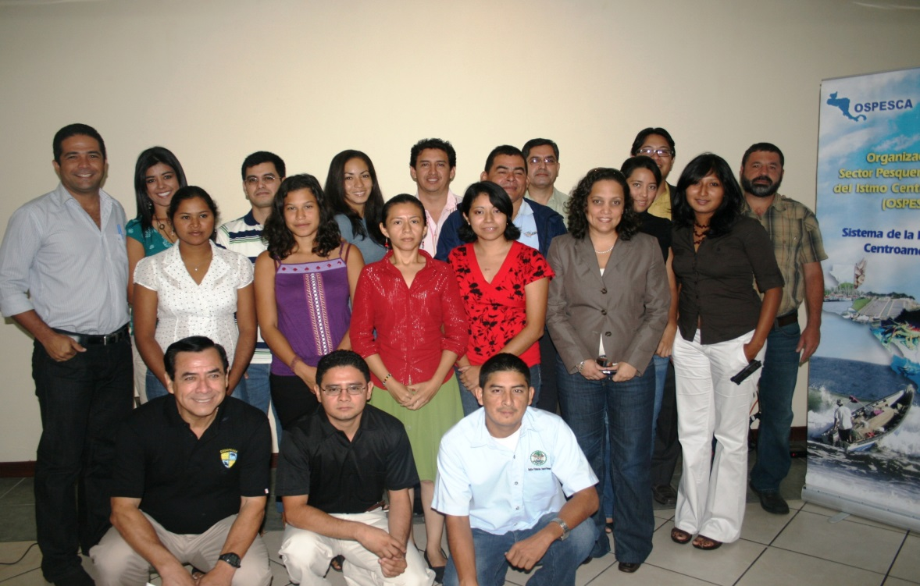
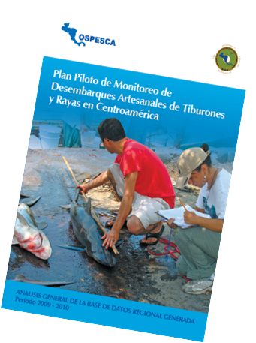
Regional Technical Shark Group
2005-2011
2005 - 2008 POA in each country
2008 Technical shark group created

Slide 4
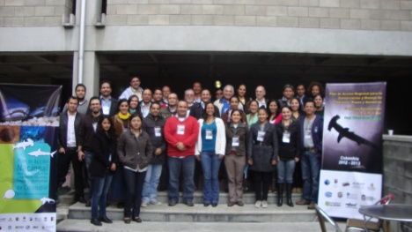
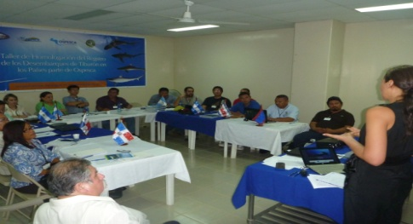
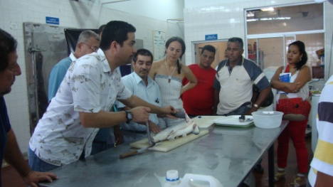
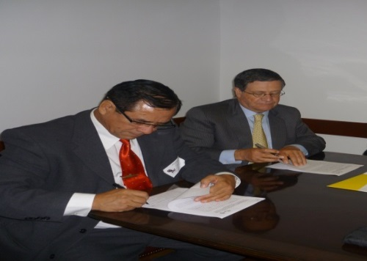

Actions by PART-Central America
        Participation in interactive populations course, CPPS – AUNAP-Colombia
        Participation in the CPPS and GTEAM meeting and recently signed MoU between OSPESCA y CPPS
        Exchange of experiences regarding Rule OSP-05-11 with Colombia
OSPESCA signs MoU with
to promote training and technical scientific exchange for the genetic study of sharks, Nov. 2011

Slide 5
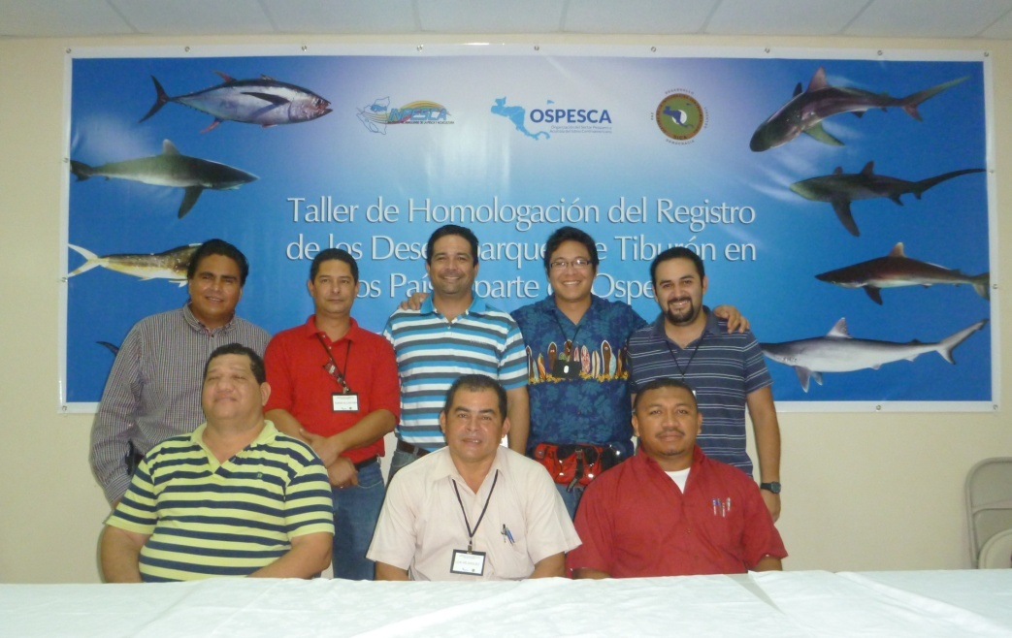
Working Group on Sharks and Highly Migratory Species (GTEAM in Spanish)
  2011
Se amplían los
Tdrs del GTEAM
Objective
Recommend, coordinate and monitor actions towards management and sustainable use and conservation of sharks and highly migratory species with a REGIONAL focus.

Slide 6
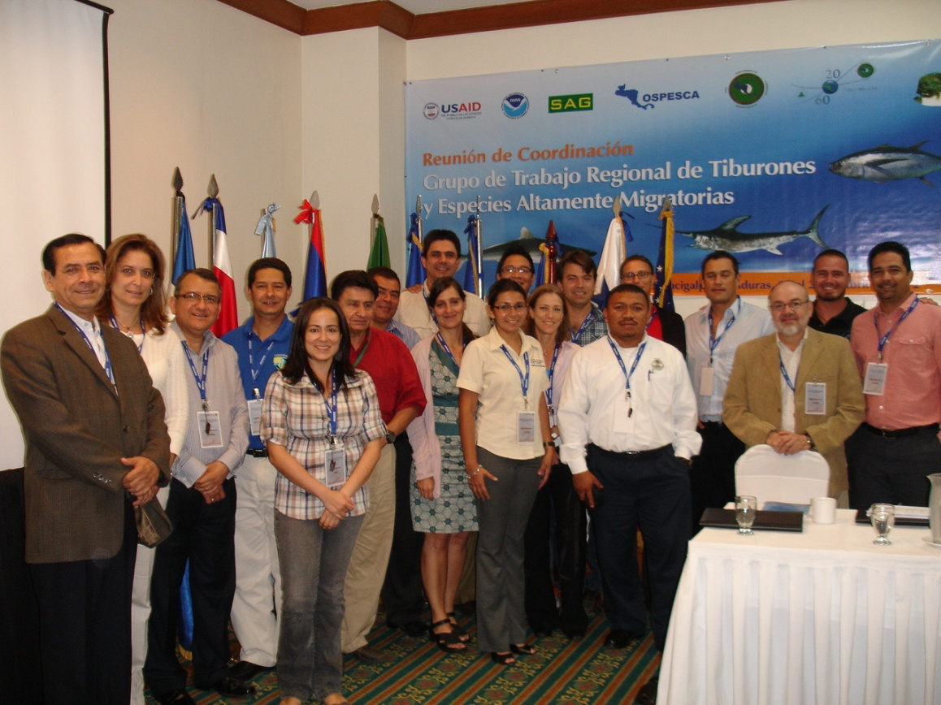
TECHNICAL GROUP ON HIGHLY MIGRATORY SPECIES (GTEAM)
prioritize activities of the Regional Shark Plan of Action with NGOs and IATTC

Slide 7
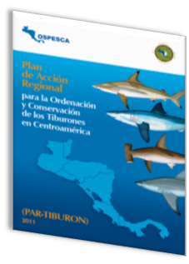
Regional Plan of Action for the Management and Cosnervation of Sharks in Central America
Action steps:
1. Research (3 goals)
2. Monitoring, control and survelliance (2)
3. Capacity building (2)
4. Education and dissemintation of information (1)
5. Coordination between governments(1)
6. Legislation (1)
7. Trade and utilization (4)
8. Financial management (2)

Slide 8
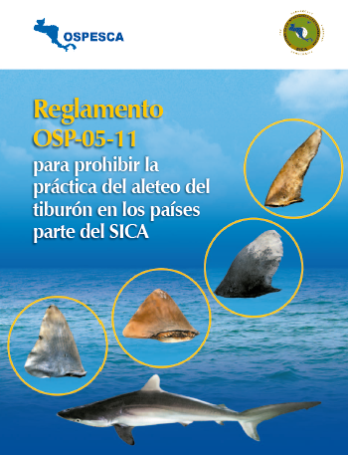
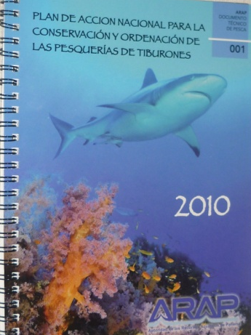
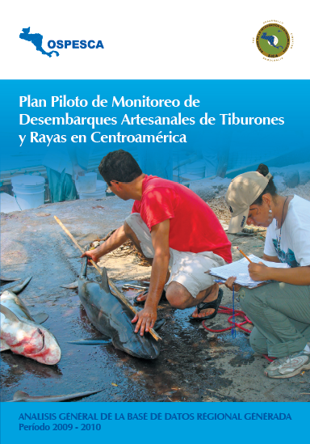
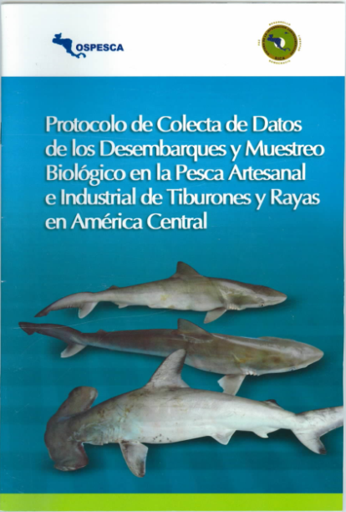
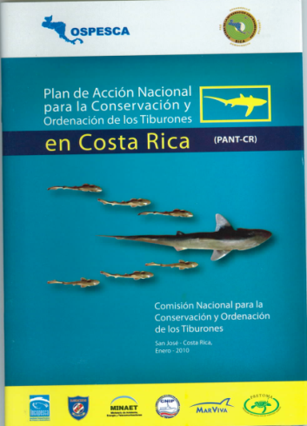
Publications

Slide 9
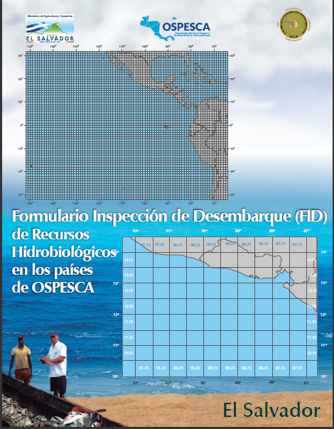
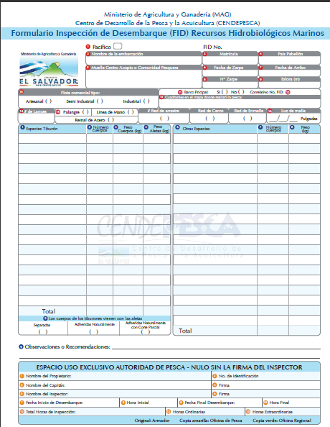
Approved Form for Inspection of Landings

Slide 10
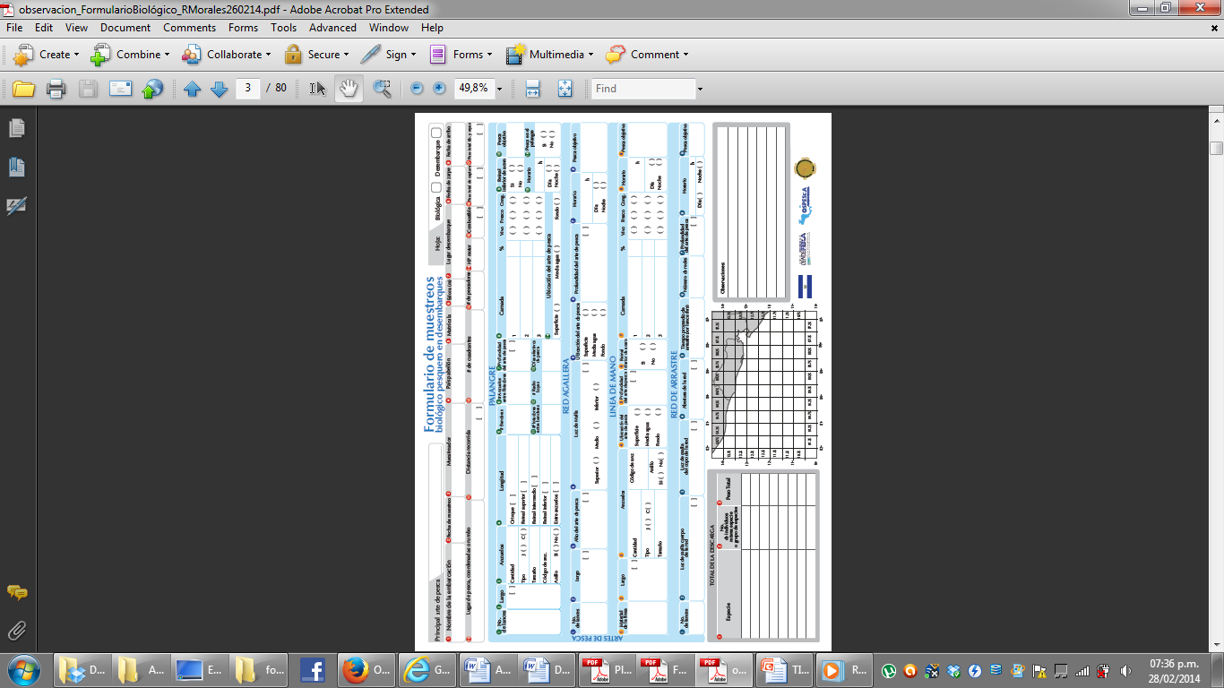
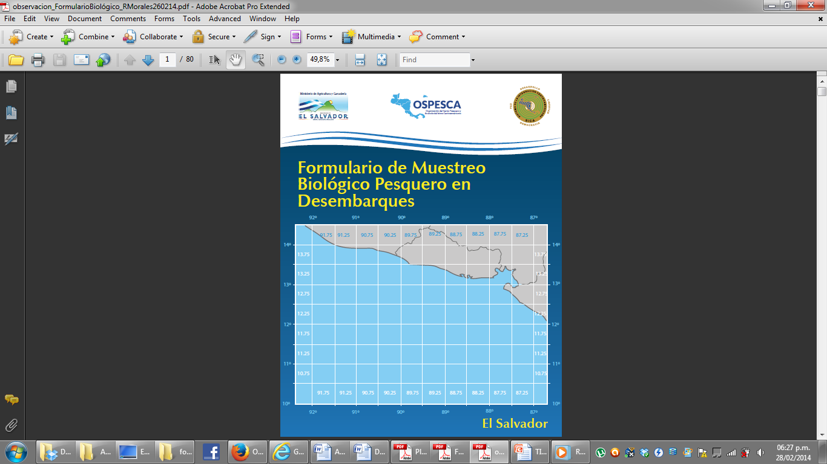
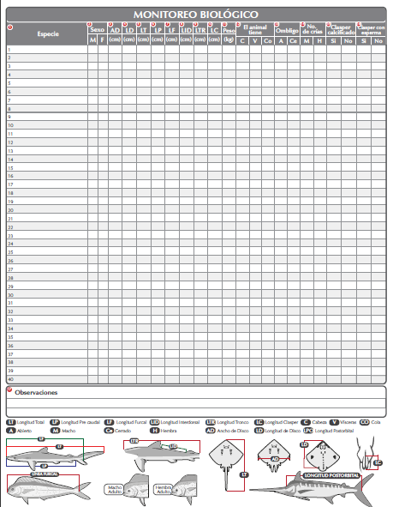
Biological samples
Information from landing

Slide 11
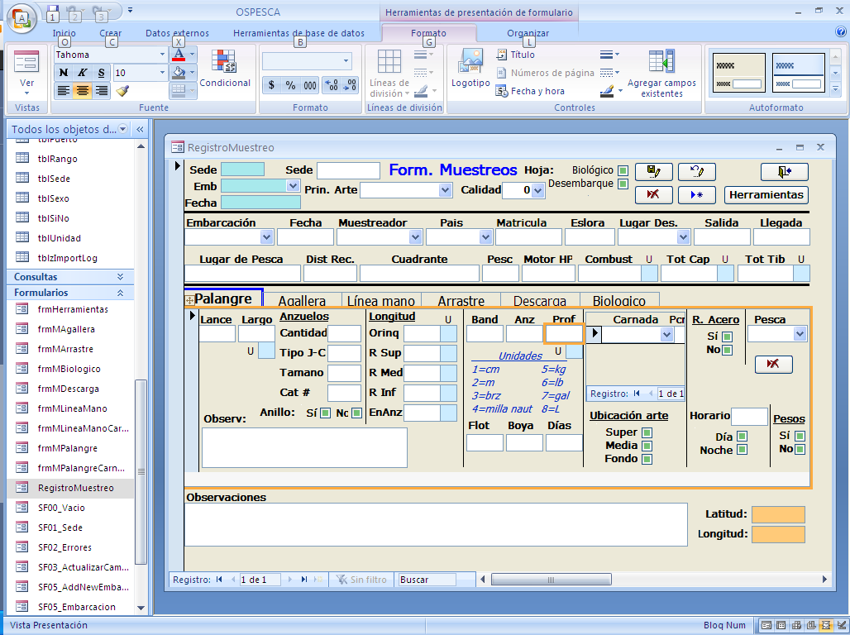
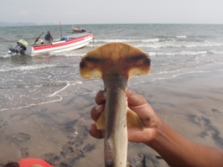
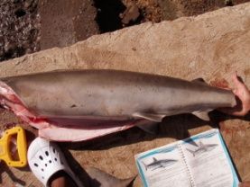
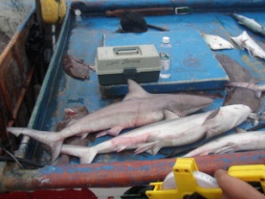
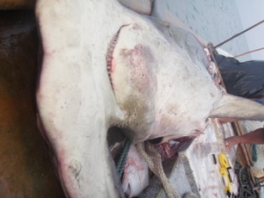
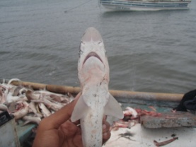
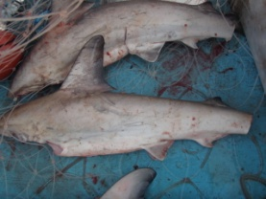
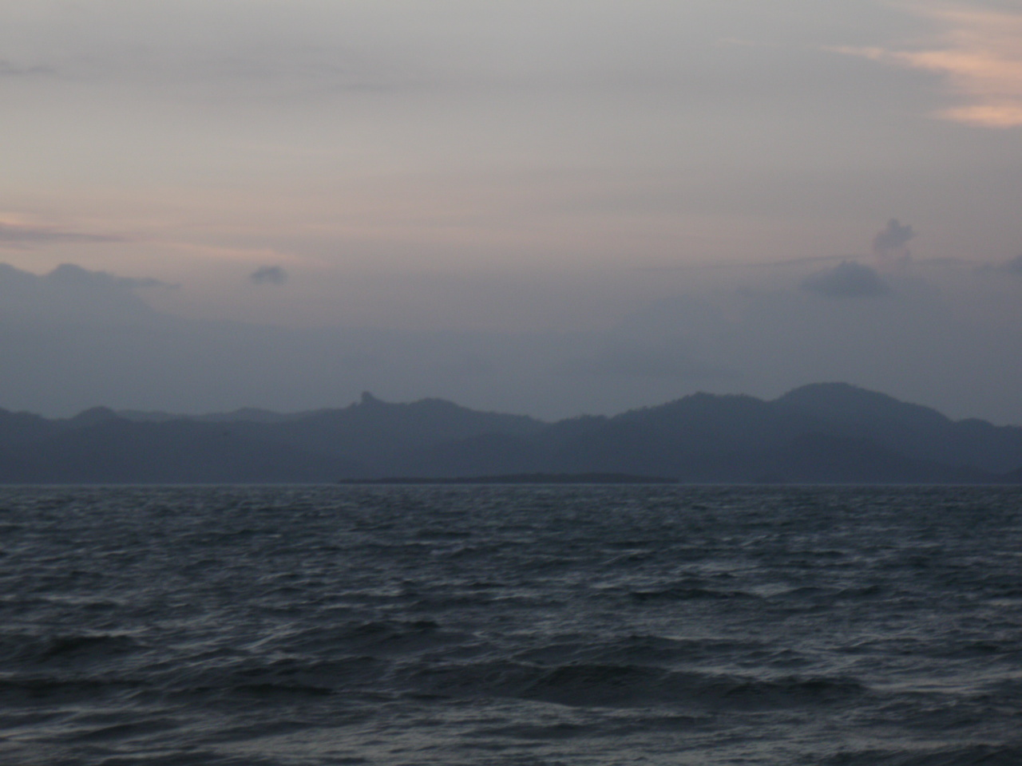
Generated a database from biological fisheries samples from landings

Slide 12
With the inclusion of the
new species of sharks and rays
CoP 16 CITES

Slide 13
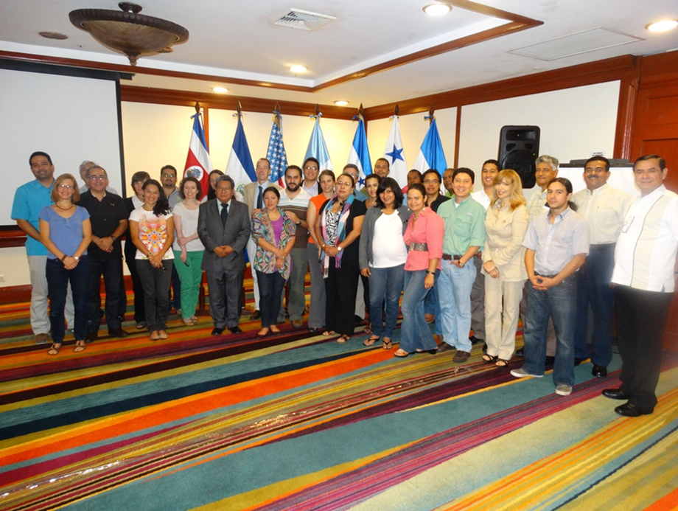

Slide 14
Background
Capacity building workshop on CITES NDFs
September 2013 (CITES, Fisheries authorities)
Exchange of experiences between coutnries in the region, experiences in developing methodologies for issuing NDFs (ex. USA & IUCN). Fisheries Service; CITES Secretariat & WCMC (Allison Ross)
Workstream developed to provide regional follow-up between authorities
Grupo de trabajo GTEAM
Acciones realizadas en el marco del GTEAM y PART
PAR-TIBURONES CENTROAMERICA
Formularios de inspección y de monitoreo
Que pesquerías se pueden monitorear con los formularios

Slide 15
Systematization of available regional information necessary for issuing NDFs (regional management tools)
2nd workshop in March 2014 Guatemala with participation of Fisheries & CITES Authorities (CITES Secretariat, Fish and Wildlife Service, NOAA, WCMC)
National visits to 7 countries in the region

Slide 16
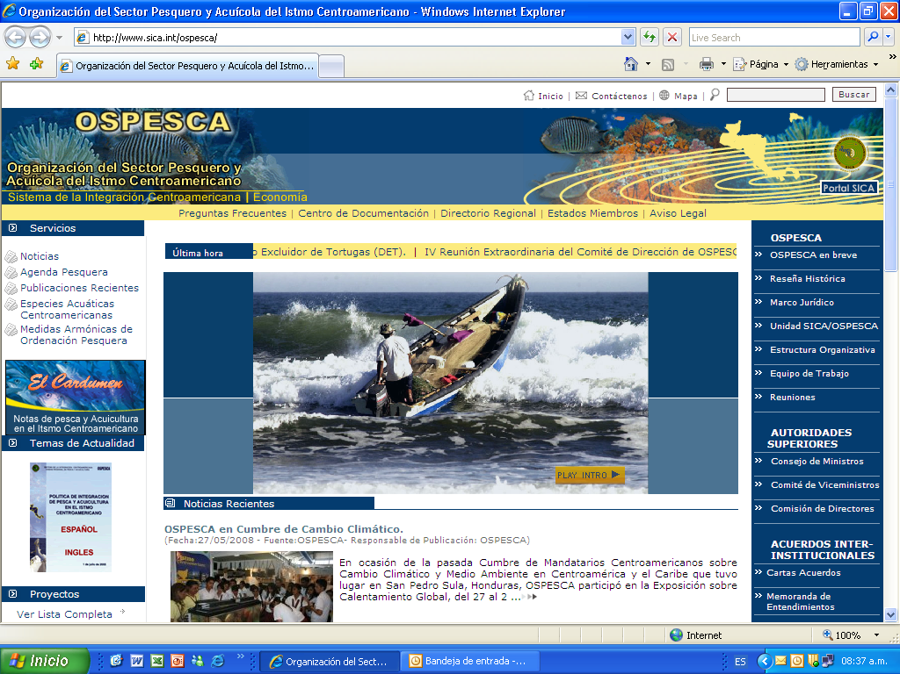

http://www.sica.int/ospesca/
SICA OSPESCA

